Slide 2
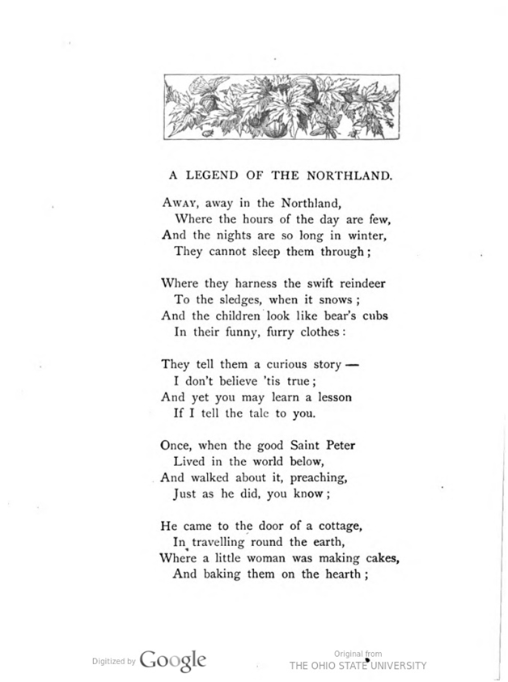

Slide 3
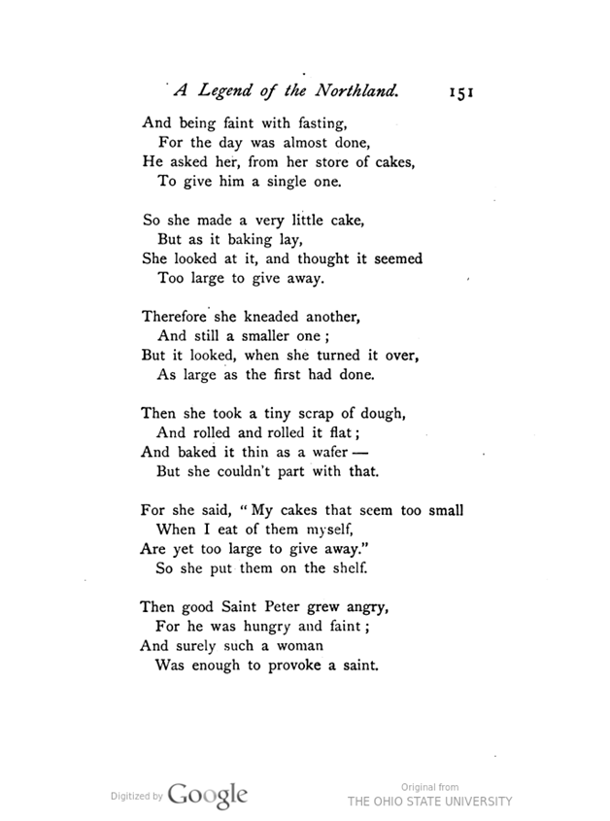

Slide 4
Introduction
‘A legend of the Northland’ is a ballad. A ballad is a poem narrating a story in short stanzas. Ballad is such kind of poem which tells a story in short stanzas and in the poem all the stanzas comprise four lines. In total, there are 16 stanzas in this poem and these stanzas will tell us a story. Ballads are a part of folk culture or popular culture and are passed on orally from one generation to the next. (Folk culture is a story of any area and is known as ballad). Folk culture comprises of traditional stories which are passed on from one generation to next generation.
This story is of the Northland area, the area which is near the North Pole. This exact place is not specified but ‘Northland’ means the area in the northernmost part of the earth i.e., near the North Pole. ‘Legend’ means a historical story, one which is very old and has been passed on from generation to generation.

Slide 5
Summary
The poem is a legend about an old lady who angered Saint Peter because of her greed. The story goes’ on like this. One day, Saint Peter was preaching around the world and reached the door of a cottage where this woman lived. She was making cakes and baking them on a hearth. St. Peter was fainting with hunger. He asked the lady to give him a piece of cake. The cake that she was baking then appeared to be too big, so she did not give him that and instead, she baked another smaller one. That also appeared to be big so she did not give him that also. The second time she baked yet another smaller cake but found it too big to give away. In the third attempt, she took an extremely little scrap of dough and rolled it flat. She had it as thin as a wafer but was unable to part with that also. This angered St. Peter a lot. He said that she was not fit to live in human form and enjoy food and warmth. He cursed her and transformed her into a woodpecker bird who had to bore in hard, dry wood to get its scanty food. She can be seen in the trees all day boring and boring for food.

Slide 6
Words Meaning
Sledges: a vehicle on runners for conveying loads or passengers over snow or ice, often pulled by draught animals.
To harness means to tie the reindeers with a rope to a sledge so that it can be used for transportation.
Swift: something which runs very fast
Saint Peter: an apostle of Christ, a disciple or follower of Jesus Christ
Preaching: to give a religious talk

Slide 7
Words Meaning
hearth: fire place where you do cooking
faint: to be weak, famished
kneaded – to make dough from flour.
provoke: cause to get angry
dwell: to live
scanty: very little
boring: make a hole in something with a tool or by digging.

Slide 8
Stanza-1
In the region around the North Pole (Northland), the duration of the day is very less because its position is such that the Sun’s rays reach for a very less time. When this area is experiencing winter season, the duration of night is very long, and the day time hours are very less. In line 4, ‘they’ refers to the people who live in this region. The poet says that the duration of the night time is so long that the people cannot sleep them through. If they go to bed, take a few hours of sleep and then, they wake up, it is still night time. He wants to emphasize on the fact that the duration of the night is very long.

Slide 9
Stanza-2
The Northland region experiences severe cold conditions. It is a snowy area. The reindeer is an animal which is found in this polar region. People tie the reindeers to sledges and then the reindeers pull the sledges. He adds that the children look like young ones of a bear because they wear funny looking clothes made of fur which is like the furry skin of a bear.

Slide 10
Stanza-3
In line 1 ‘they’ refers to the parents or elders and ‘them’ refers to the children or the younger generation. The elders of the Northland region tell a strange and interesting story to the younger generation. The poet says that he doesn’t think that the story is true, but if he tells the story to the reader, maybe the reader could learn a lesson from it. The story gives an important message.

Slide 11
Stanza-4
The story is about Saint Peter. When Saint Peter used to live in the world and went around, giving religious lectures to the people just like all saints do, then an incident happened.

Slide 12
Stanza-5
When Saint Peter was moving around the world, giving religious lectures to the people, he reached the door of a cottage where a small woman was making cakes. She was baking the cakes in the fireplace.

Slide 13
Stanza-6
As Saint Peter had not eaten anything the entire day, he was very hungry and was feeling weak. So, he went to this woman who was baking cakes and he asked for one cake out of the many cakes that she had baked.

Slide 14
Stanza-7
The woman was selfish. She did not give cake from her store. Instead, she started making a very small cake for Saint Peter. She did not want to share her things. But, when she put the cake for baking, she looked at it and thought that this cake was too big to be given to someone

Slide 15
Stanza-8
The little miser woman thought that the cake was too big to be given away. So, she started making another smaller cake. When she looked at that cake, she again felt that it was as big as the previous one. Again, she was not ready to give this smaller cake to Saint Peter.

Slide 16
Stanza-9
The third time, she took a very small amount of dough and rolled it. The poet says that she rolled and rolled to lay emphasis on the fact that she rolled the dough and made it very thin like a wafer and baked it. But she was so greedy that she couldn’t give that thin piece of bread to the saint.

Slide 17
Stanza-10
The woman reasoned that, when she ate the cakes, she felt that they were very small but if she had to give them to someone, she felt that they were too big to be given away. She put all the cakes on the shelf of her kitchen and she did not give any cake to Saint Peter.

Slide 18
Stanza-11
Saint Peter became angry. He was very hungry, he was feeling very weak and the selfish woman was not ready to give him even a small cake. This behavior of the greedy woman angered the saint.

Slide 19
Stanza-12
Saint Peter cursed the woman and said that she was very selfish. She did not deserve to live like a human being. He added that God had given her food, shelter, fire to keep warm but she had become selfish for all the resources she had. She did not want to share them with anybody.

Slide 20
Stanza-13
Saint Peter cursed the woman that hence, she would become a bird because she did not deserve the human form. She shall become a bird and just like birds build their houses by boring into the wood and collect very little food by working hard the entire day, similarly, she would also work hard in the dry wood, all day and get little food and make a small place for herself to live in.

Slide 21
Stanza-14
As soon as Saint Peter cursed the woman, she did not get a chance to speak for herself because that very moment, she flew up to the roof through the chimney and flew out in the form of a bird. Saint Peter’s curse had converted the woman into a bird.

Slide 22
Stanza-15
When the woman turned into a bird, at that time she was wearing a red - coloured cap on her head. This cap was there on the bird’s head also, but the woman’s remaining clothes had burned and turned black in colour just like coal.

Slide 23
Stanza-16
People who live in the countryside, even the small children who go to school, seen this kind of bird in the woods. They see that she stays there all day and keeps on digging the wood with her beak, to collect her food. Whenever any child sees this kind of bird, then his elders tell him this story. They say that the bird used to be a woman earlier. She was very greedy and so, she was cursed by Saint Peter and turned into a bird. They get a teaching that they should not be greedy.

Slide 24
Figures of Speech/Poetic Devices
1. Rhyme Scheme: abcb
2. Alliteration: is the repetition of a consonant sound in two or more close words.
Stanza 1 - that, they, them through - ‘th’ sound is repeating
Stanza 2 - they, the - ‘th’ sound is repeating
look, like - ‘l’ sound is repeating
funny, furry - ‘f’ sound is repeating
Stanza 3 - they, them- ‘th’ sound is repeating
yet, you - ‘‘y sound is repeating’
learn, lesson - ‘l’ sound is repeating
tell, tale, to - ‘t’ sound is repeating

Slide 25
Stanza 5 - woman, was – ‘w’ sound is repeating
Them, the, hearth - ‘th’ sound is repeating
Stanza 6 - faint, fasting - ‘f’ sound is repeating
Stanza 8 - still, smaller - ‘s’ sound is repeating
Stanza 9 - took, tiny -‘t’ sound is repeating
Stanza 10 - seem, small - ‘s’ sound is repeating
Stanza 13 - build, birds - ‘b’ sound is repeating
by, boring, boring – ‘b’ sound is repeating

Slide 26
3. Repetition: any word or sentence is repeated to lay emphasis on it.
Stanza 1 - ‘away’ word is repeated
Stanza 9 – ‘rolled’ word is repeated
Stanza 13, 16 – ‘boring’ word is repeated
4. Enjambment: running lines of poetry from one to the next without using any kind of punctuation to indicate a stop
Stanza 1 - line 3 and 4
Stanza 2 - Line 1 and 2; line 3 and 4
Stanza 3 - Line 3 and 4
Stanza 4 - Line 1 and 2; 3 and 4
Stanza 10 - Line 1, 2 and 3
Stanza 11 - Line 1 and 2
5. Simile: Comparison using ‘as’ or ‘like’
Stanza 2 – ‘the children look like bear’s cubs’. Children compared to bear’s cubs
Stanza 9 – ‘baked it thin as a wafer’. Cake is compared to a wafer.
Stanza 15 – ‘clothes were burned black as a coal’. The colour of the burned clothes is compared to that of coal.

Slide 27
Thank You!

